Slide 1

Where do
[Entrepreneurs]
come from?

Slide 2

How do you
picture them
inside your head

Slide 3


Slide 4

We start to ENVY
soon it turns to jealousy
“The scariest moment in life occurs
when we start to believe
nothing we do is ever going to
make a difference，
so we just comfortably
STOPPED doing anything。”
ENVY

Slide 5

MythBuster!
[What is Success?]

Slide 6
MythBuster!
The secret to success has always been a vague and general concept.
The path to success comes from a combination of your desire to be better and intolerance towards the current situation.
The secret to success is not slogan or daydreaming, it is Attitude and knowledge.
The secret to success is not fantasize or concern, it is Action and Practice.
In fact, JUST DO IT

Slide 7

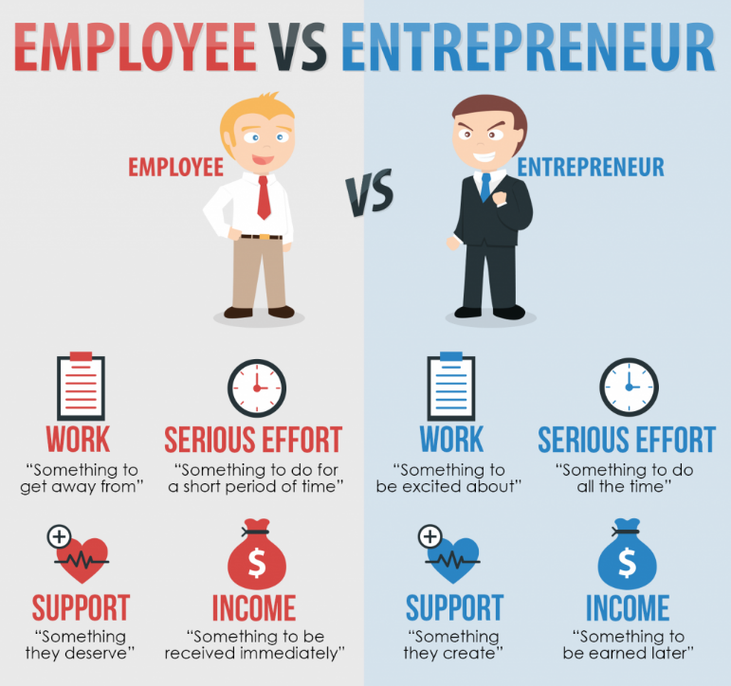
The difference between entrepreneur and employee never EXISTED
The key is
who started to DO it

Slide 8
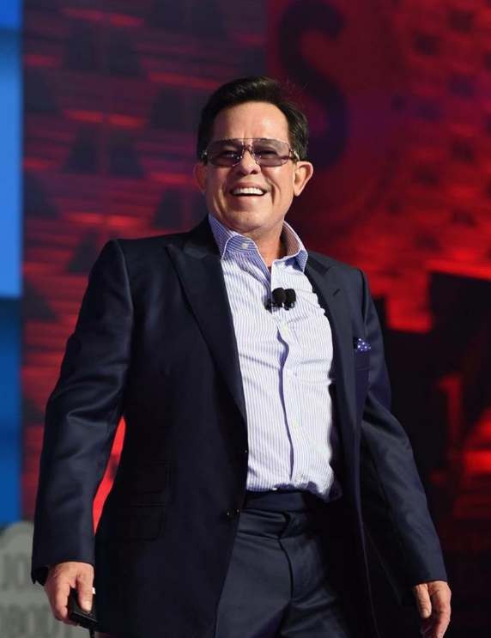
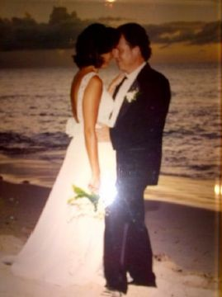
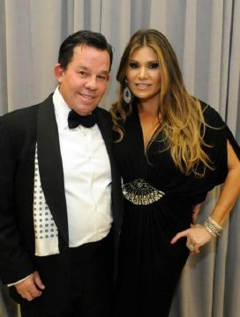
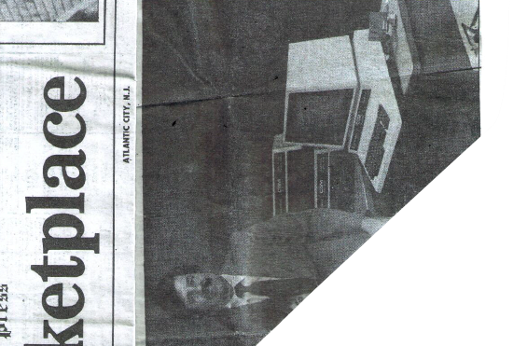

Slide 9
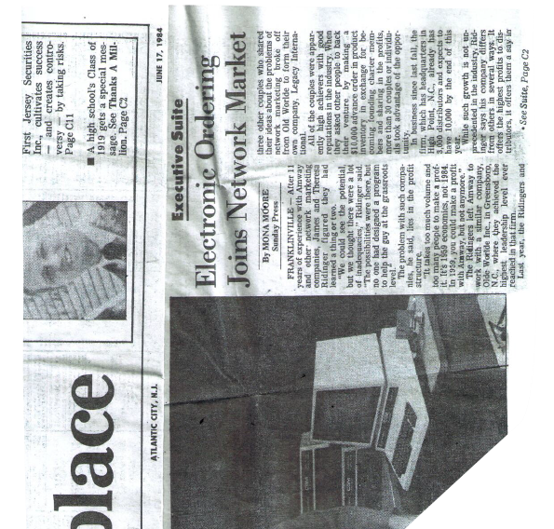

JR Ridinger news article in 1984
JR said：「Network marketing is the next trend. Within 5 years, computers will be as common as telephones. People would be able to place orders with computers.」

Slide 10
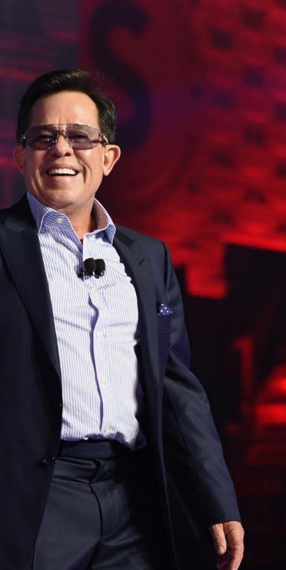


MARKET AMERICA’S
MISSION STATEMENT
WHAT IS IT?
Market America is a Global Product Brokerage and Internet Marketing company specializing in one to one marketing through the Shopping Annuity providing a blue print for success with the UnFranchise® Business Opportunity where average people can attain financial independence by creating their own economy.
“Creating our own economy” has always been in there

Slide 11
The road to
[Entrepreneurship]
starts with YOU

Slide 12
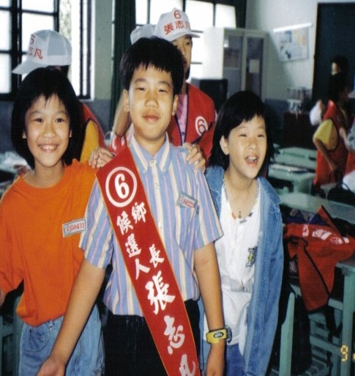

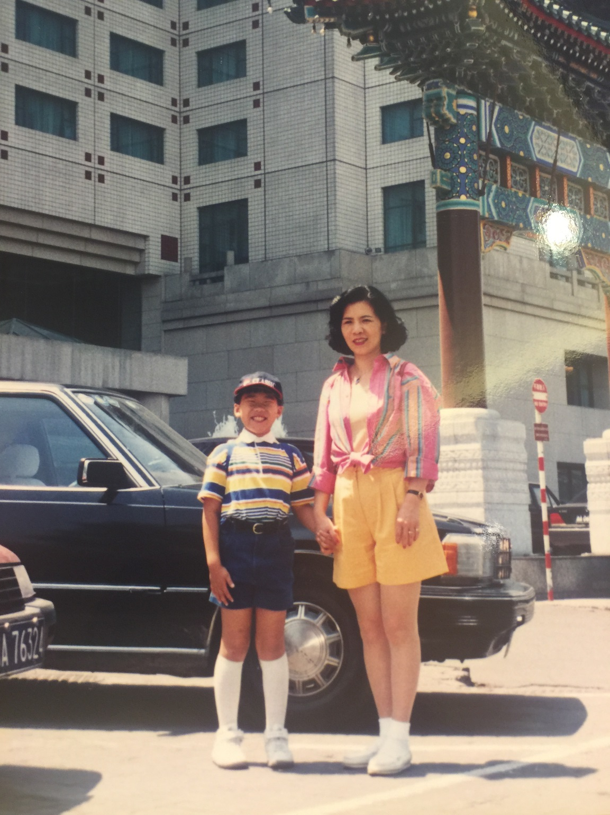

Slide 13





Slide 14
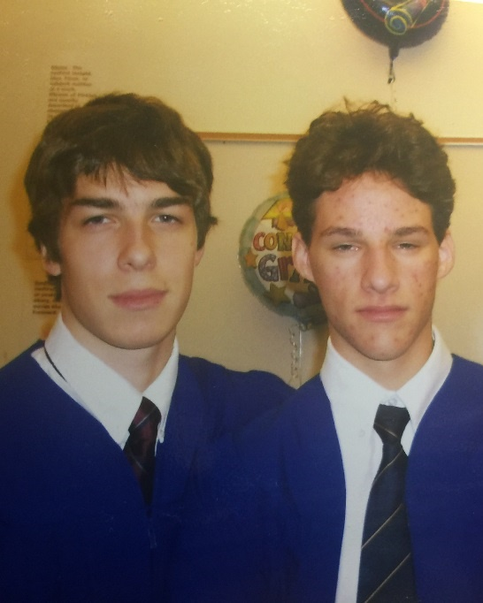
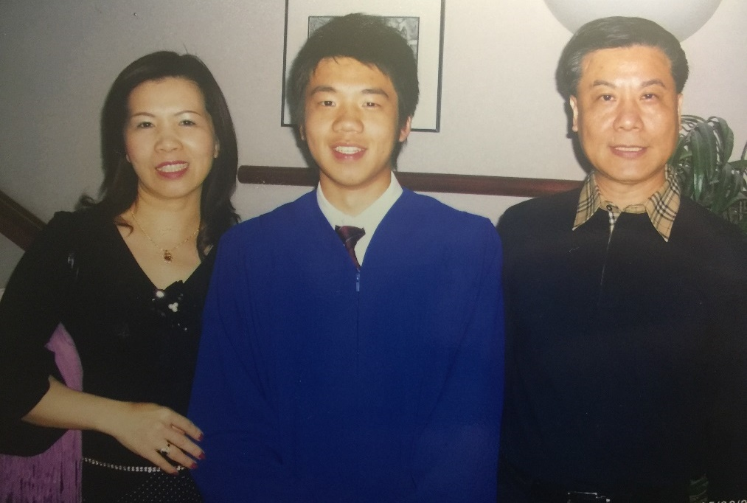
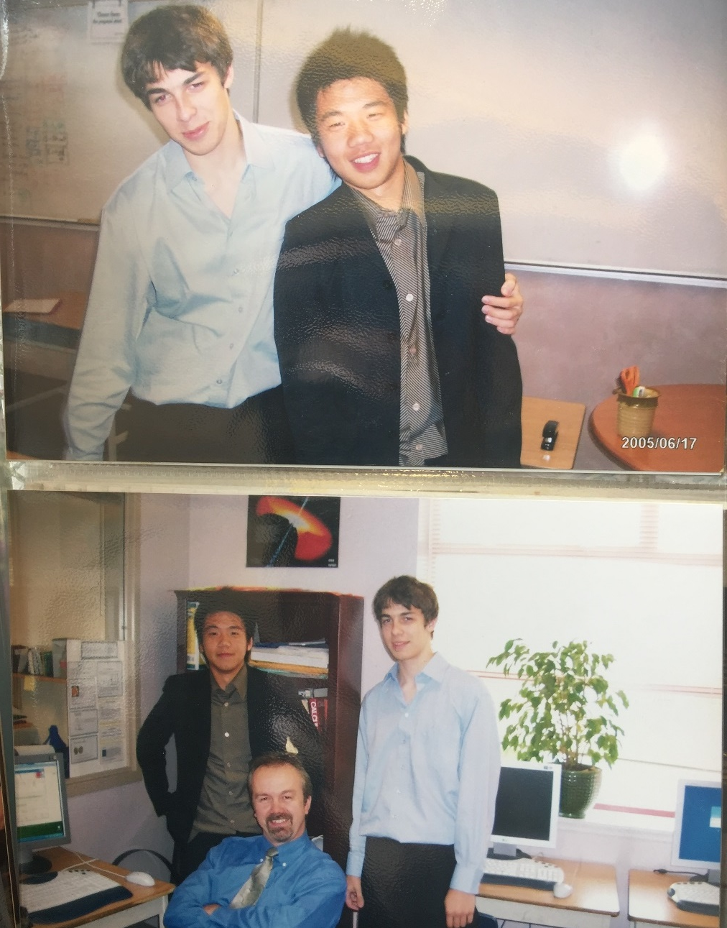
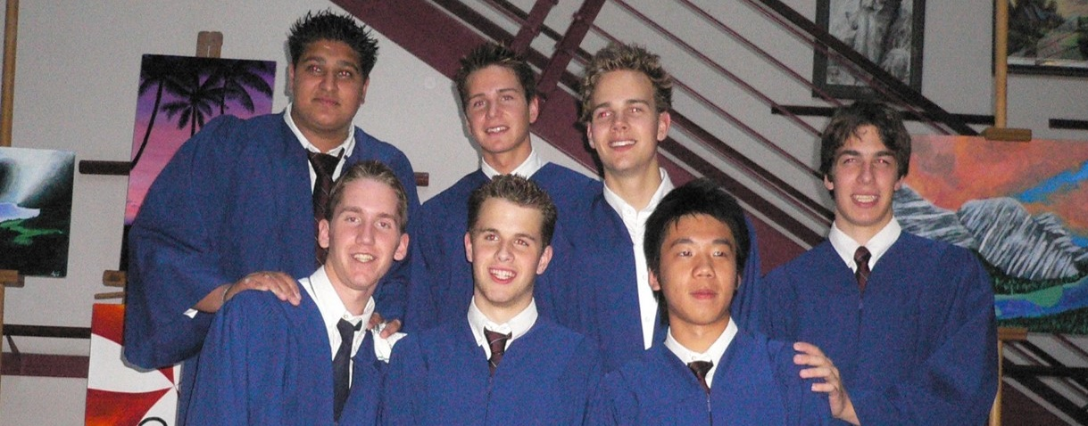

Slide 15

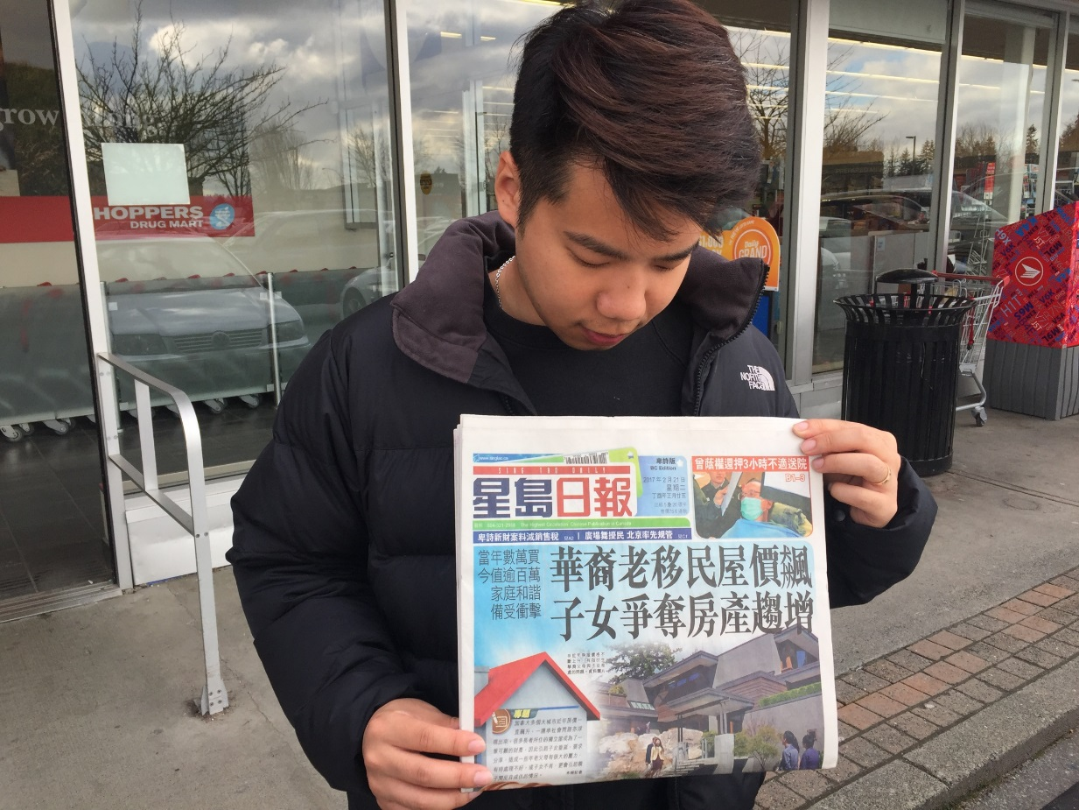
My biggest fear in life
CAME TRUE !!

Slide 16

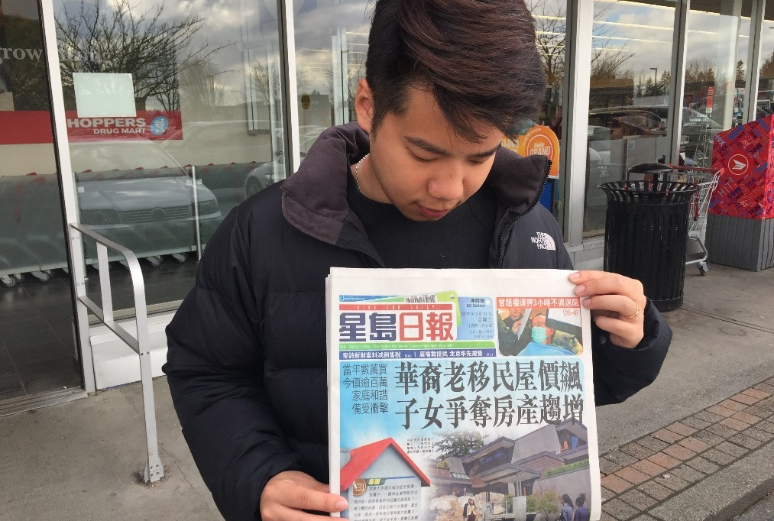

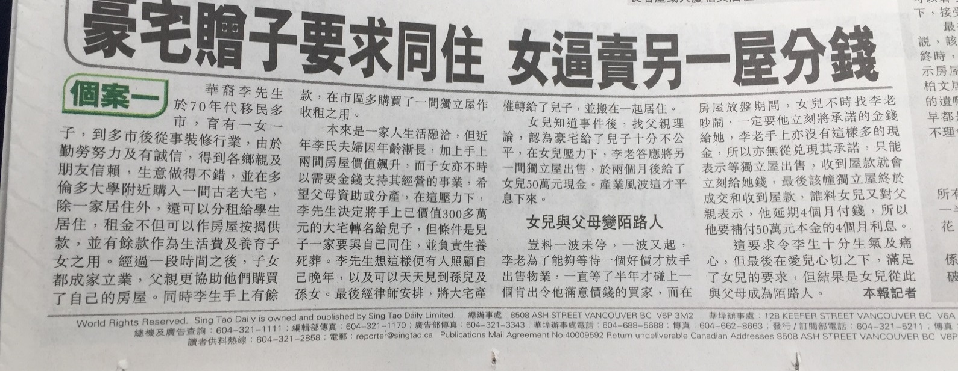

Slide 17
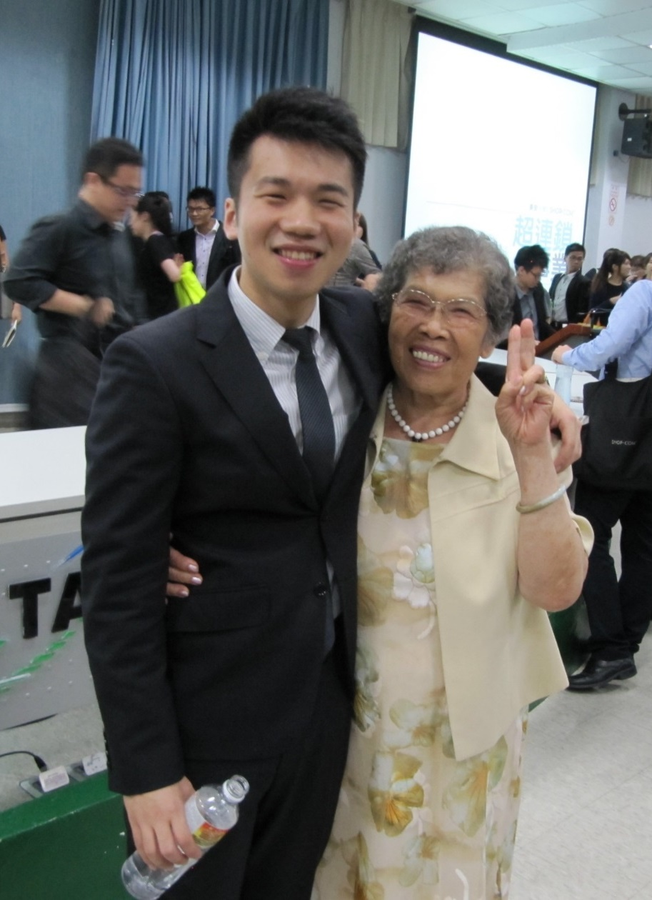

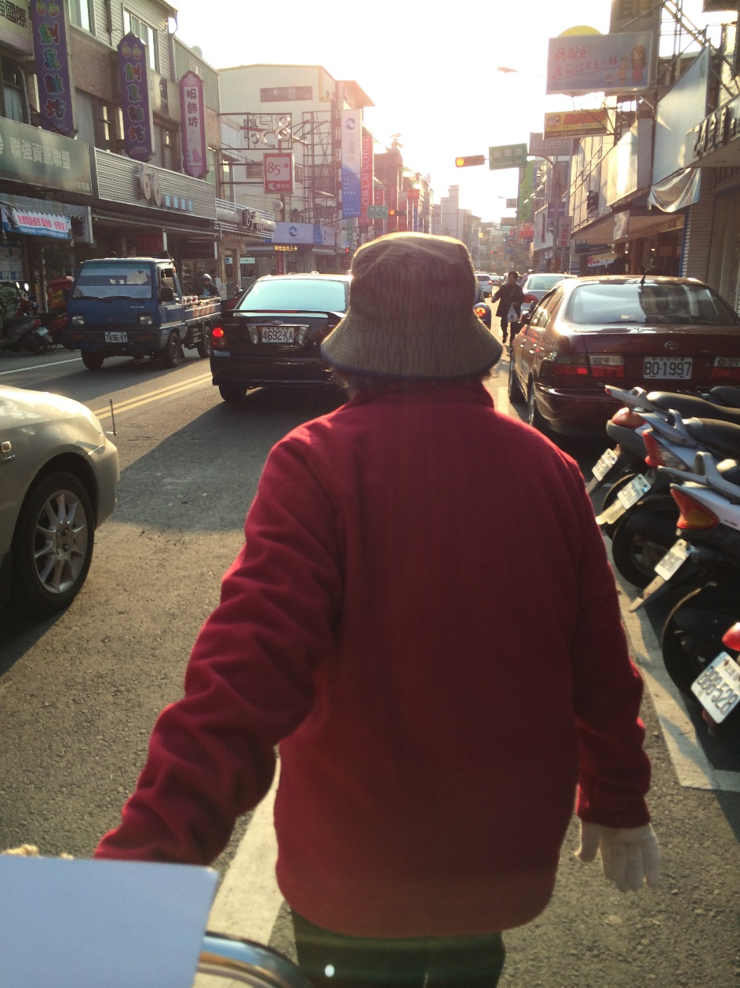
What residual income means to ME

Slide 18
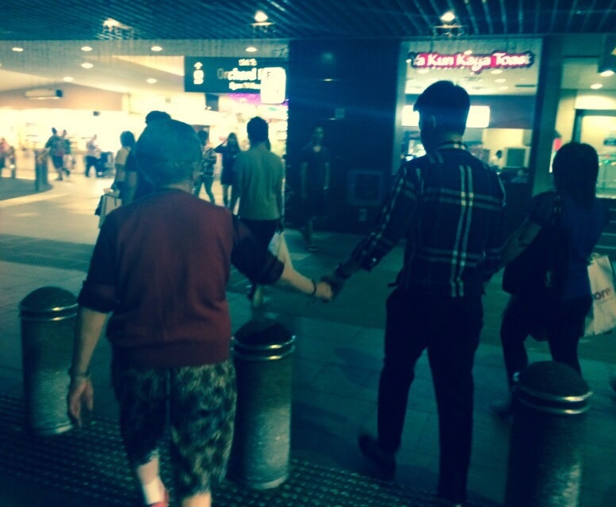

小時候妳牽著我的手去買糖，
長大後我牽著妳的手去看世界 。

Slide 19
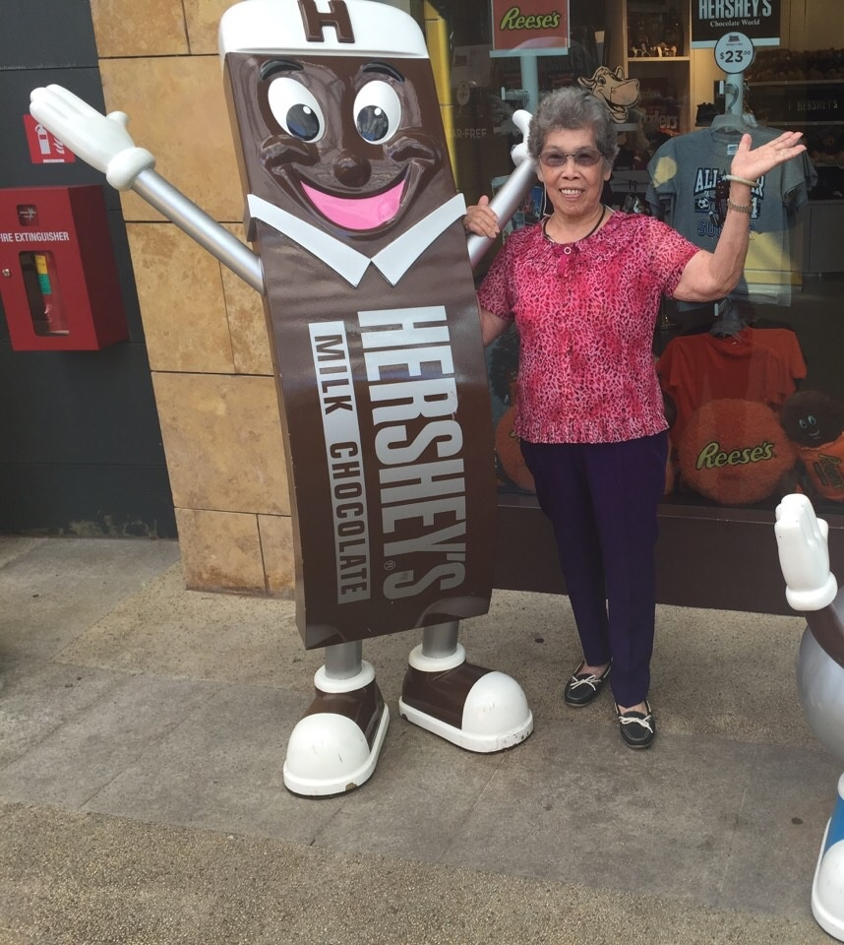
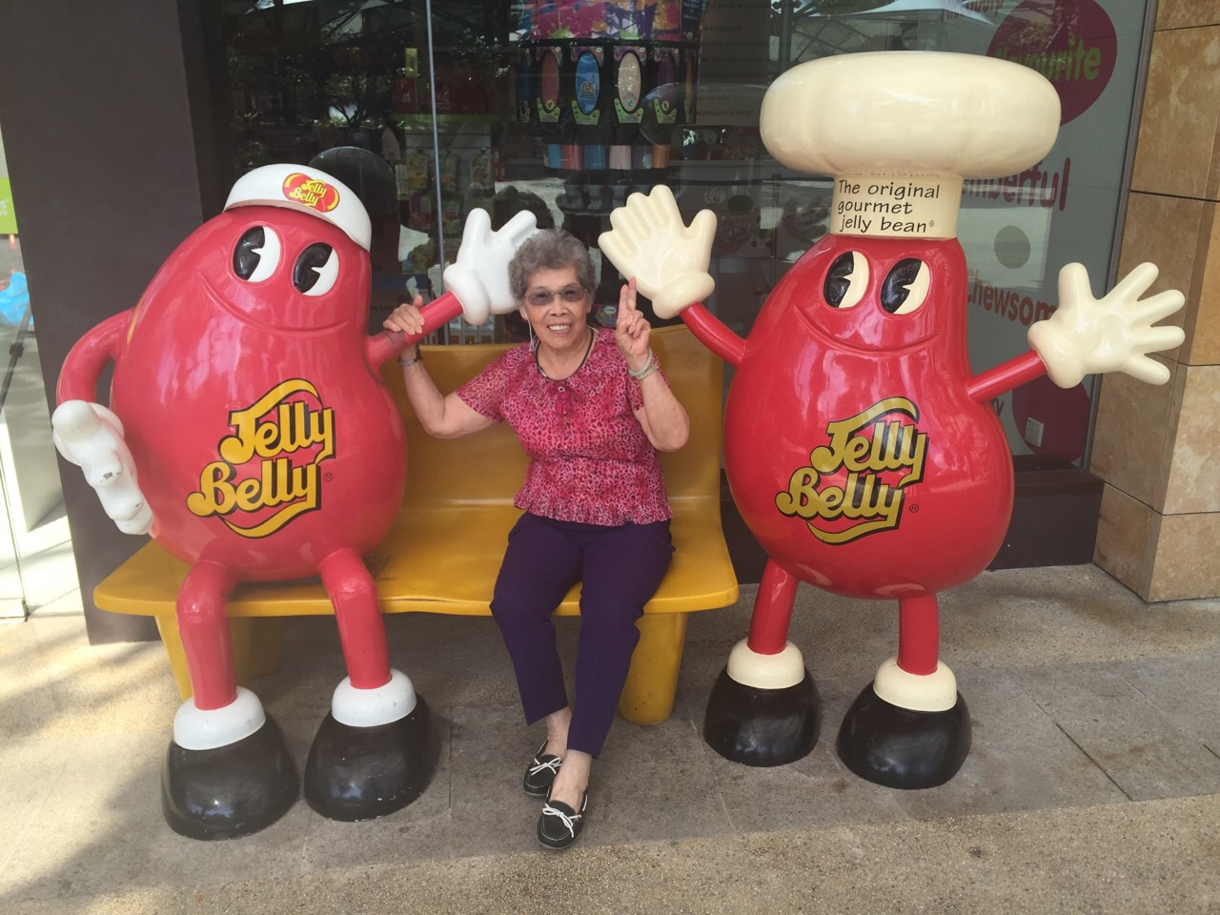
What residual income means to ME

Slide 20
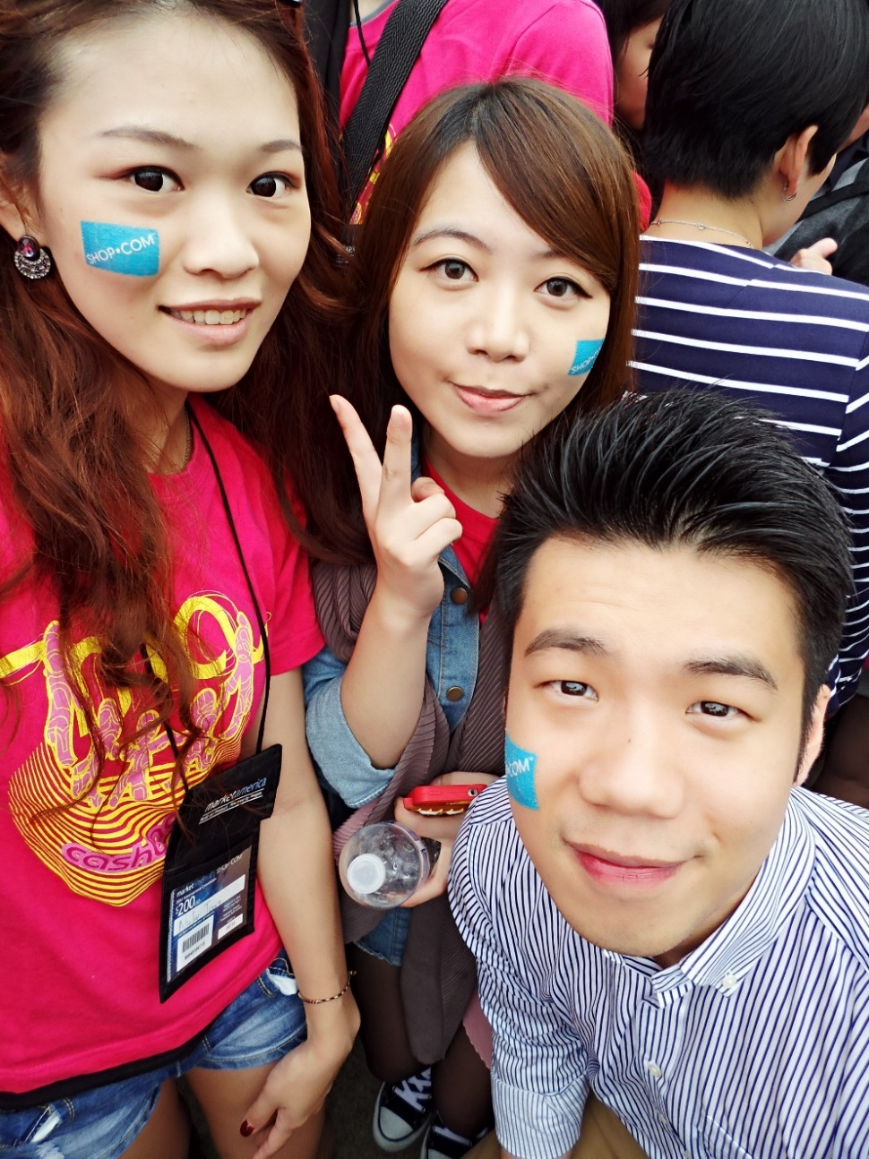
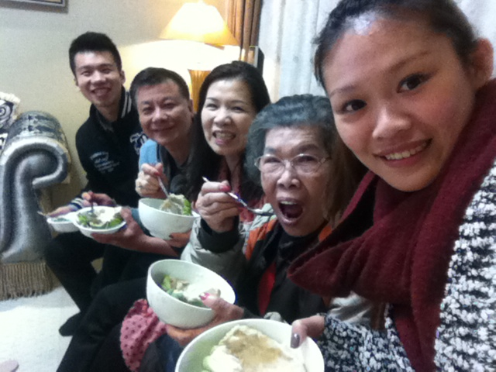
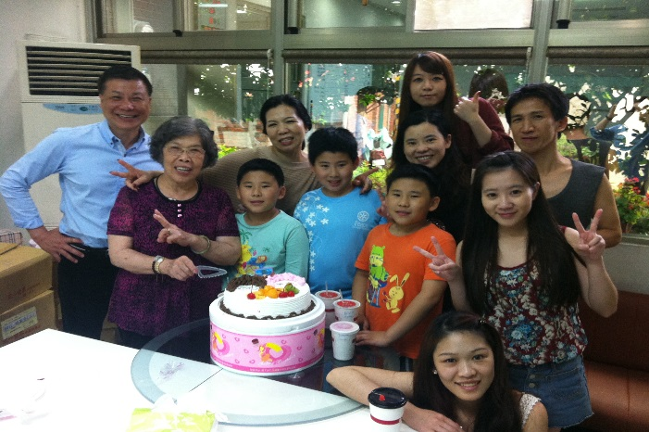
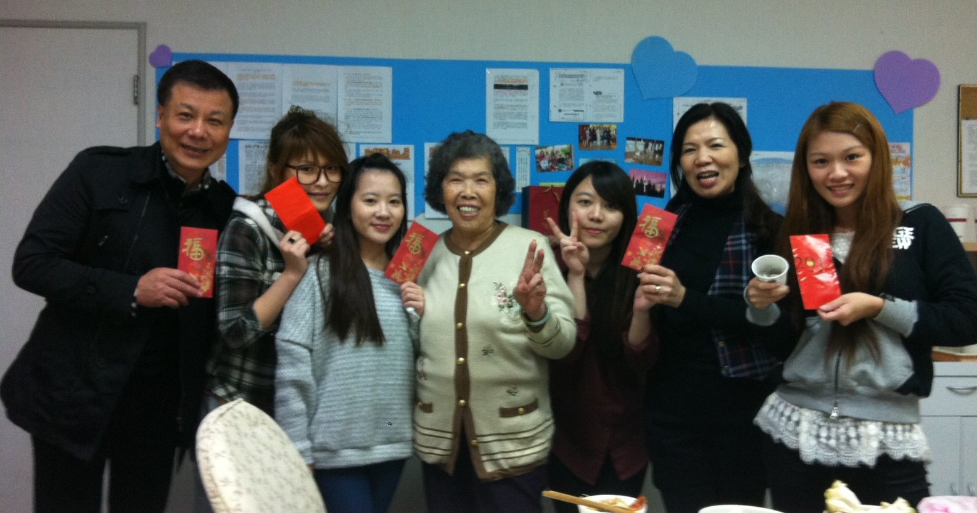
What residual income means to ME

Slide 21

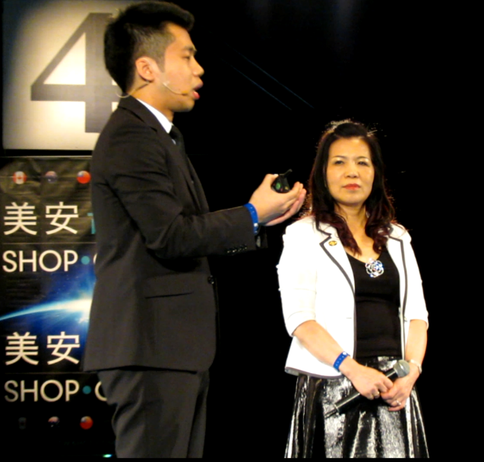

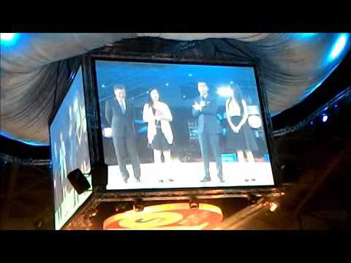

What residual income means to ME

Slide 22
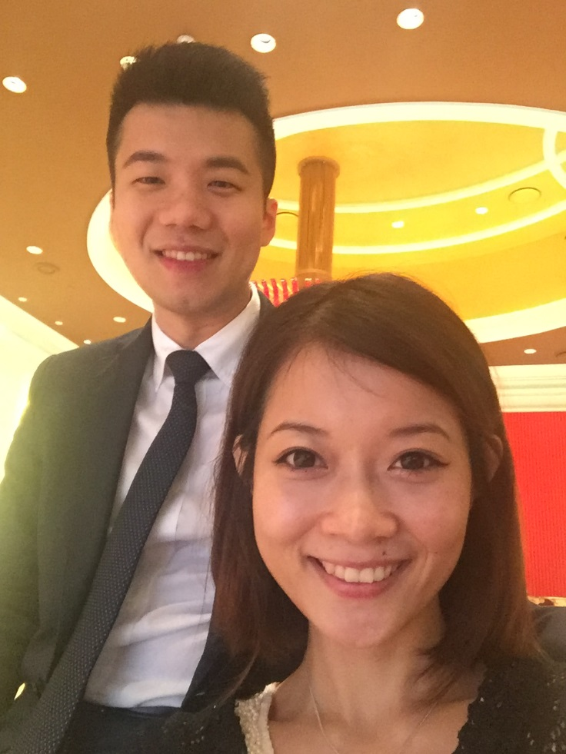


What residual income means to ME

Slide 23


GIFTS !!

Slide 24


The best gift you can give to your PARENTS is
GLORY

Slide 25

The best gift you can give to your FRIENDS is
HOPE

Slide 26


The best gift you can give to your SELF is
ACCOMPLISHMENTS

Slide 27

The best gift you can give to your PARTNER is
EXAMPLE

